Slide 1



Traffic Signal Violation Detection and Automatic E-challan Generation
Presented By :
Enrollment Number | Name
ET21BTCO003 | Tirth Asodariya
ET21BTCO007 | Aditya Bhakhar
ET21BTCO030 | Kaushal Gadhiya
ET21BTCO032 | Manan Gajera
ET21BTCO037 | Aryan Jadav
Faculty Mentor:
Prof. Jaydeep Gheewala

Slide 2
1
Introduction
This project uses advanced technologies to detect traffic signal violations and automatically generate e-challans. By employing computer vision and machine learning, the system monitors intersections in real-time, identifies violations, and issues fines directly to offenders.

Slide 3
2
Problem Statement???
Improving Road Safety: Real-time detection and penalization of violators reduce accidents and encourage adherence to traffic signals.
Efficiency: Automated systems reduce the need for manual monitoring and intervention, saving time and resources.
Revenue Generation: Efficient fine collection supports municipal budgets and can fund further improvements in traffic infrastructure.

Slide 4
3
MODULES
Data Collection
Object Detection
Signal Violation Detection
Number Plate Detection
E-challan Generation
1
2
3
4
5

Slide 5
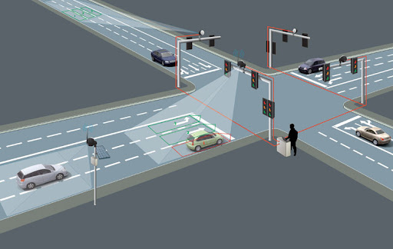
4
MODULE 1: DATA COLLECTION
Install and configure video cameras at the selected intersections.
Capture traffic footage as per the specified times and locations.
Preprocess the collected video data by extracting frames and cleaning the data to remove noise.
Annotate the data to mark instances of traffic signal violations for training purposes.

Slide 6
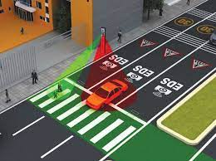
5
MODULE 2: Object Detection
Develop algorithms to detect vehicles in the video footage.
Validate the accuracy of the detection system using annotated data.

Slide 7
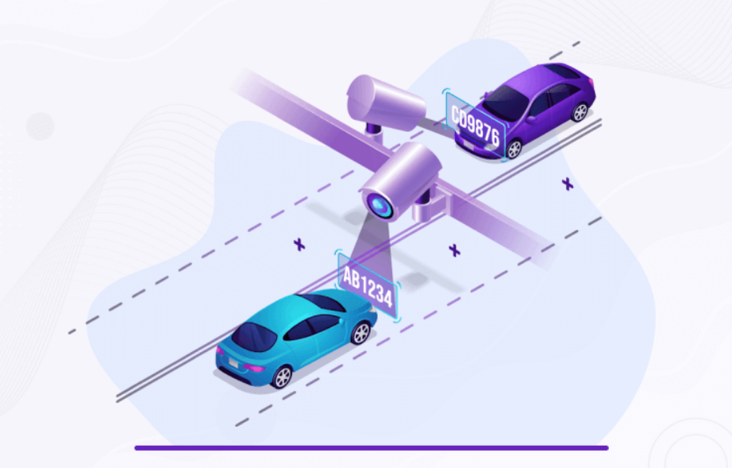
6
MODULE 3: Signal Violation Detection
Implement machine learning or deep learning models to identify signal violations such as signal jumping.

Slide 8
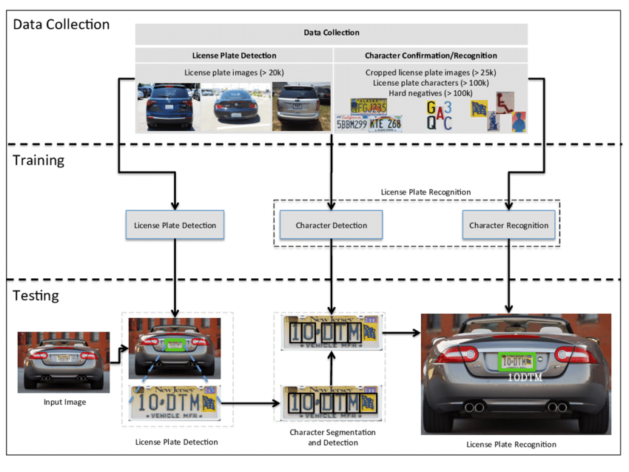
MODULE 4:
Number Plate Detection and Tracking
7

Slide 9
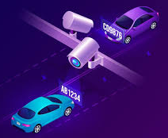
MODULE 4:
Number Plate Detection and Tracking
8
This module starts by detecting traffic signal violations, then uses License Plate Recognition (LPR) technology to identify the number plates of the offending vehicles.
Advanced machine learning algorithms Identifies and reads number plates from images.
optical character recognition (OCR) are employed to accurately read the number plates.

Slide 10
MODULE 5:
Automatic E - Challan Generation
9
Violation Confirmation: Validate that a violation occurred by cross-referencing signal status, vehicle position, and detected number plates.
Challan Generation:
- Details: Include vehicle number, violation type, time, location, and fine amount.
- Format: Generate electronic challans in a format like PDF or HTML.
Issuance:
- Notification: Send e-challans via email or SMS to the vehicle owner.
- Payment Integration: Provide a payment gateway for fine payment. Ensure secure transactions and receipt generation.

Slide 11
Workflow
10
Capture Image: Camera captures vehicle image and timestamp.
Process Image: Apply LPR to extract the number plate.
Check Signal Status: Verify if the vehicle crossed the white line during a red signal.
Generate Challan: Create an e-challan with all relevant details.
Store Data: Save images, violation details, and challans in the database.
Notify and Issue Fine: Send the e-challan to the vehicle owner and provide a payment option.

Slide 12
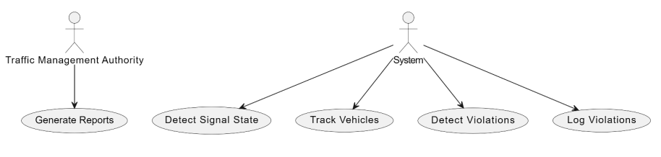
Usecase Diagram:
11

Slide 13
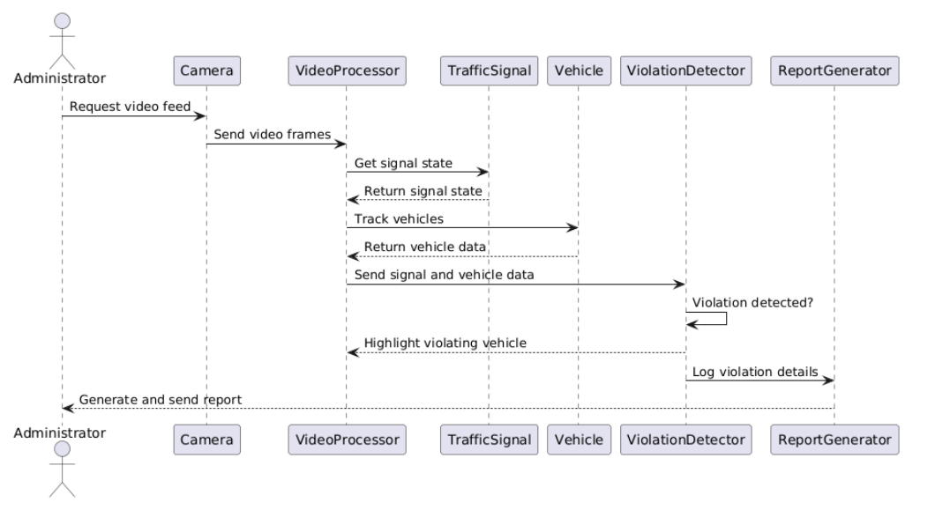
12
Sequence Diagram:

Slide 14
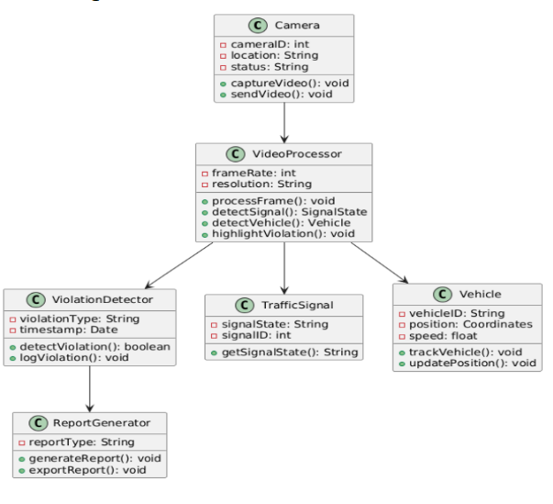
Class Diagram:
13

Slide 15
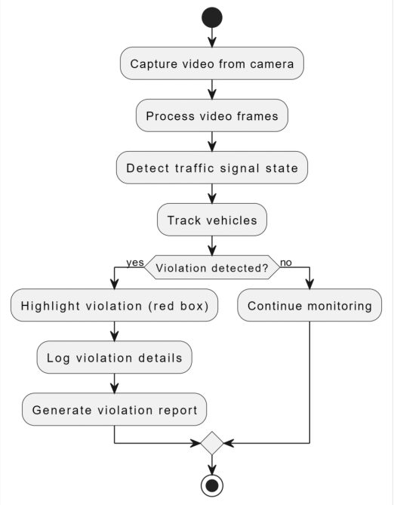
Activity Diagram:
14

Slide 16
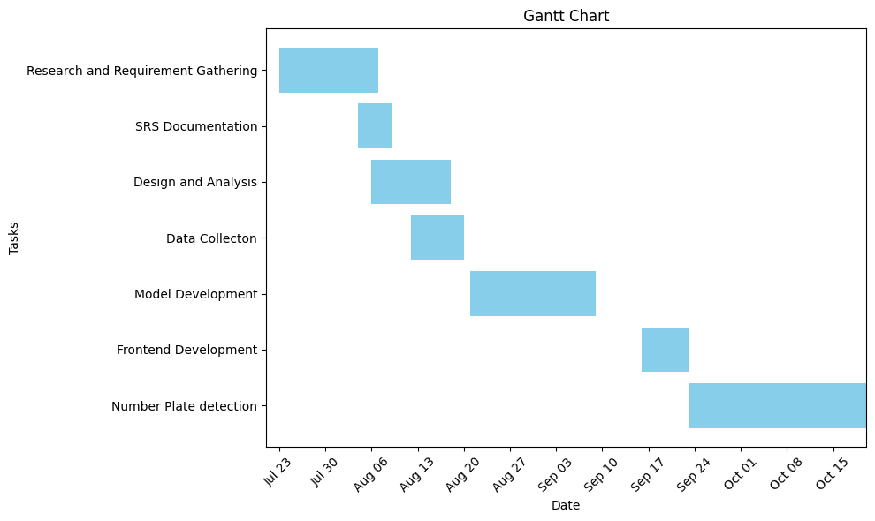
Gantt Chart:
15

Slide 17
Conclusion
16
Developed an automated system for detecting traffic signal violations and generating e-challans.
Enhanced traffic law enforcement and improved road safety through AI and video analysis.
Successfully reduced traffic violations and provided valuable insights for traffic management.
Future work: Expand coverage, integrate more data sources, and refine AI techniques.
Acknowledgements: Thanks to SCET, Surat Police Commissioner’s office, faculty mentors, and project team.

Slide 18
THANK YOU
Presented By : Group 10d1

